Slide 1


Lesson 2
We are all different
UNIT 1

Slide 2


LPLAY A GAME
TWO TRUTHS AND A LIE
Write down three ‘facts’ about yourself - two things that are true, one thing that is a lie. Tell your classmates what you wrote.
Can they guess which one is a lie? They might ask you some extra questions.

Slide 3
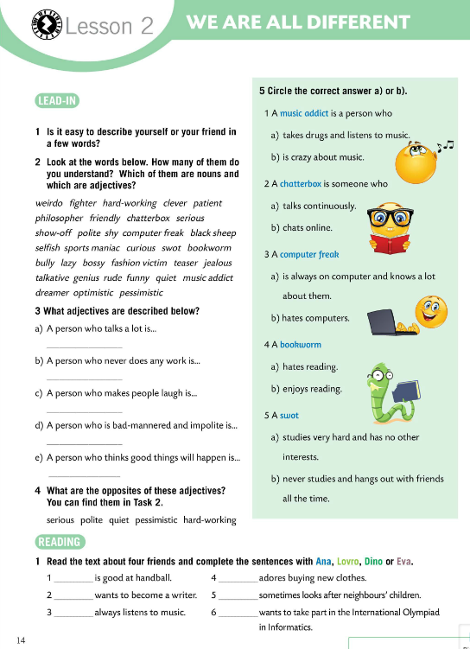
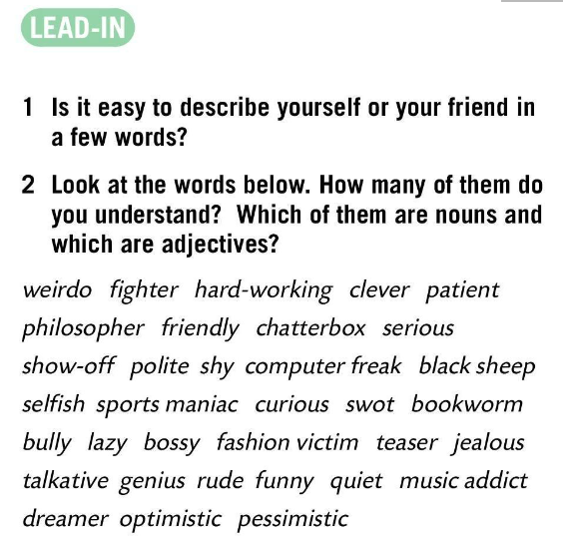
Is it easy to describe yourself or your friends in a few words? Why?
Which of the words are nouns and which are adjectives?
weirdo (n)–čudak
fighter (n)–borac
hard working (adj)–marljiv
clever (adj)-pametan
patient (adj)–strpljiv
philosopher (n)-mislilac, filozof
friendly (adj)-prijateljski raspoložen
chatterbox (n)-brbljavac
serious (adj)-ozbiljan
show-off (n)-hvalisavac
polite (adj)-pristojan
shy (adj)-sramežljiv
computer freak (n)-kompjutorski fanatik
black sheep (n)-crna ovca
selfish (adj)-sebičan
sports maniac (n)- ljubitelj sporta
curious (adj)-znatiželjan
swot (n)-štreber
bookworm (n)-knjiški moljac
bully (n)-nasilnik
lazy (adj)-lijen
bossy (adj)-sklon zapovijedanju
fashion victim (n)-žrtva mode
teaser (n)-zadirkivač
jelaous (adj)-ljubomoran
talkative (adj)-razgovorljiv
genius (n)-genije
rude (adj)-nepristojan
funny (adj)-zabavan
quiet (ajd)-tih
music addict (n)-ovisnik o glazbi
dreamer (n)-sanjar
optimistic (adj)-optimističan
pessimistic (adj)-pesimisitičan

Slide 4
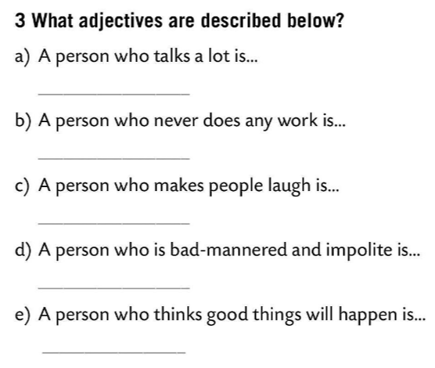
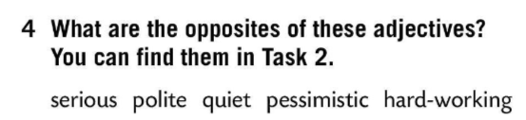
What adjectives are described?
Check.
What are the opposites of these adjetives?
You can find them in Task 2.
talkative
lazy
funny
Check.
serious – funny
polite – rude
quiet – talkative
pessimistic – optimistic
hard-working – lazy
rude
optimistic

Slide 5
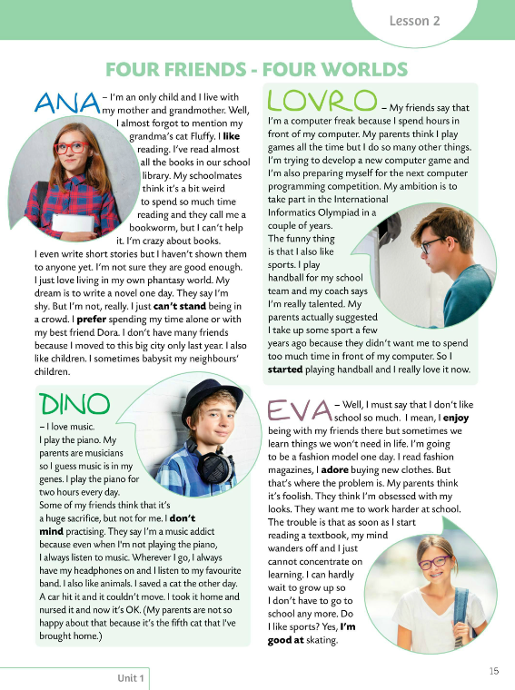
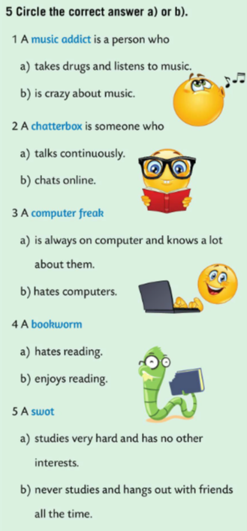
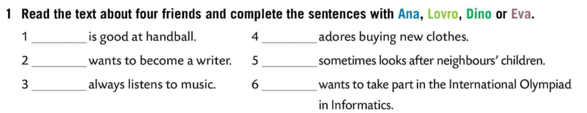
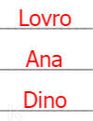
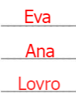
Read the questions and circle the correct answer a) or b).
Check.
Read the text about four friends and complete the sentences with Ana, Lovro, Dino or Eva.
Check.
Describe yourself in a couple of sentences.

Slide 6
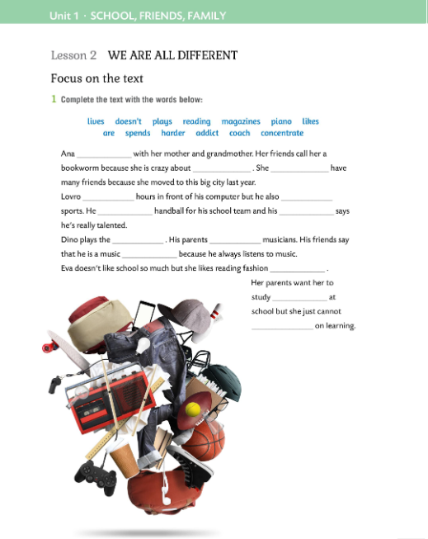

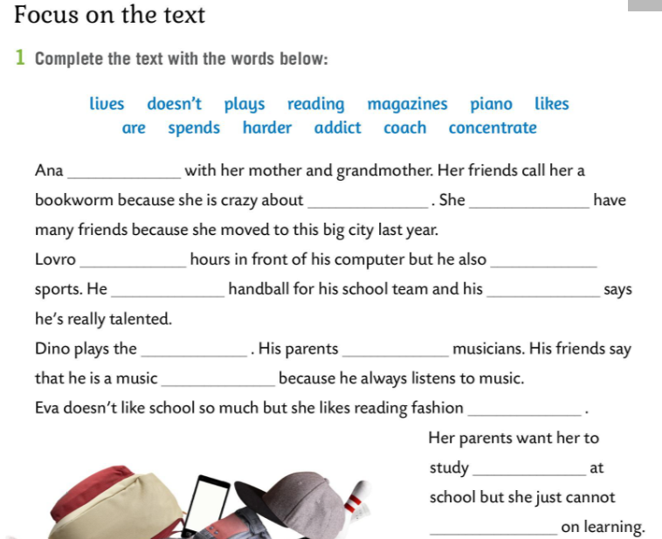
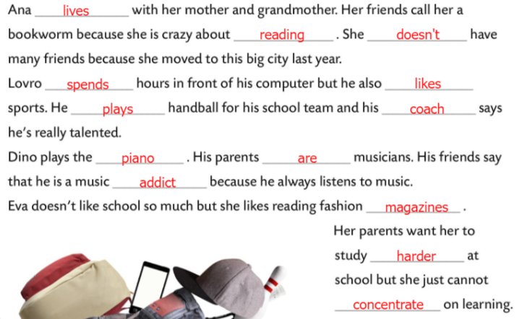
Workbook, page 12
Complete the text with the words below.
Check.

Slide 7
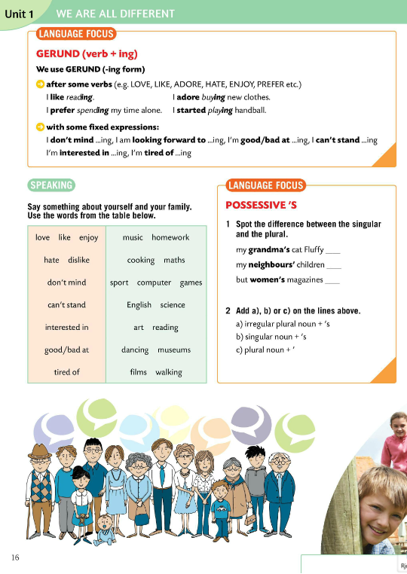
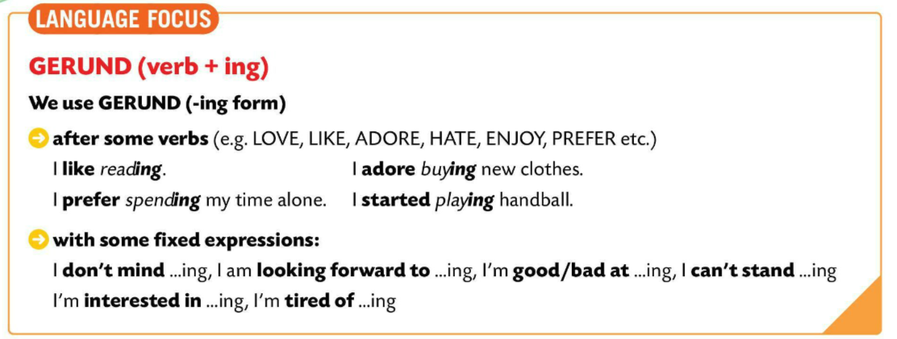
LANGUAGE FOCUS - GERUND
We use GERUND (VERB +ING) with some fixed expressions:
Gerund (glagol + nastavak -ing) koristimo uz neke ustaljene izraze:
I don’t mind … -ing. I am looking forward to …-ing.
I’m good/bad at …-ing. I can’t stand…. -ing.
I’m interested in …-ing. I’m tired of … -ing.
We use GERUND after some verbs.
LOVE, LIKE, ADORE, HATE, ENJOY, PREFER etc.
Gerund koristimo nakon nekih glagola (LOVE, LIKE, ADORE, HATE, ENJOY, PREFER itd.)
I like reading.
I adore buying new clothes.
I prefer spending my time alone.
I sarted playing football.

Slide 8
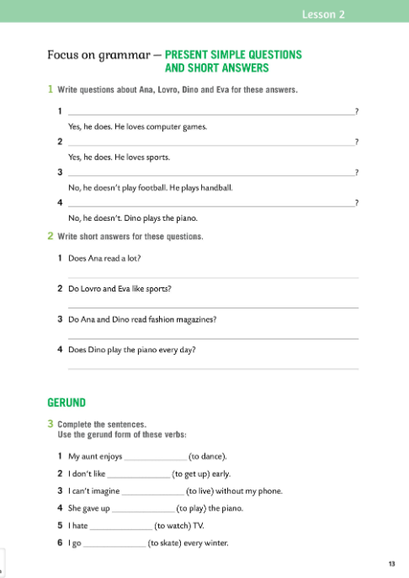
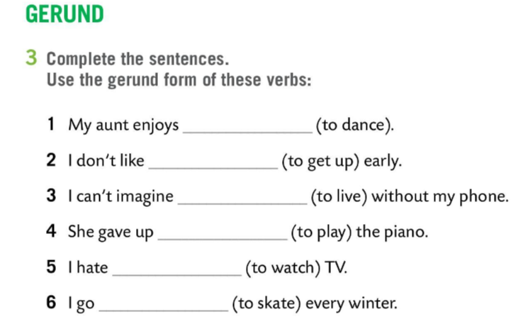
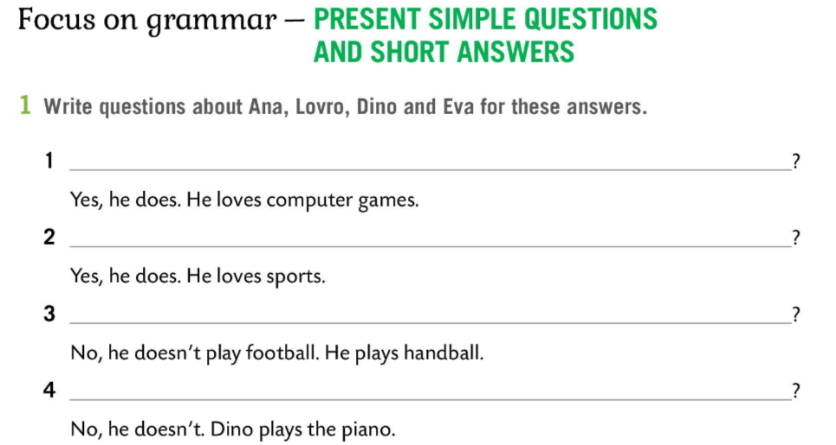
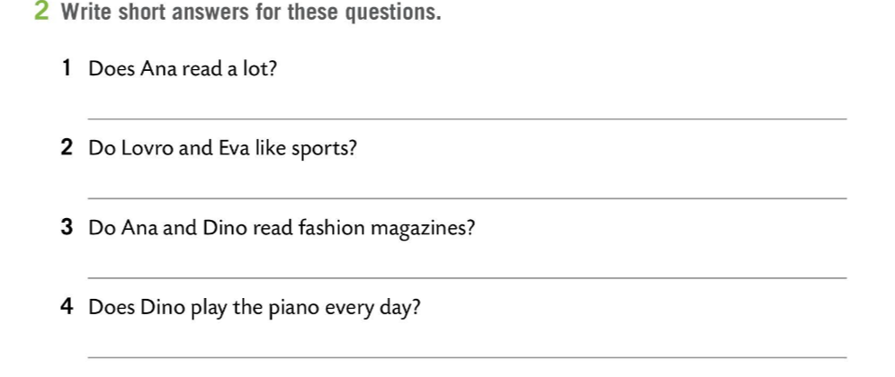
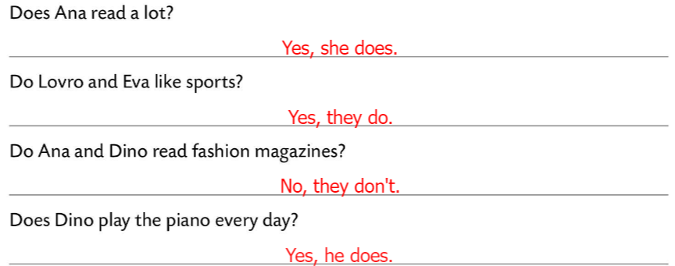
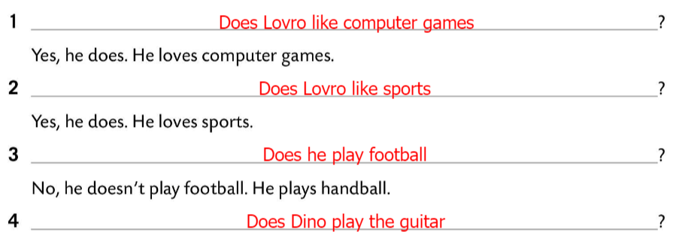
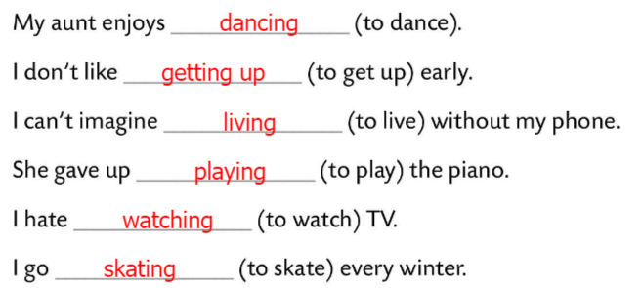
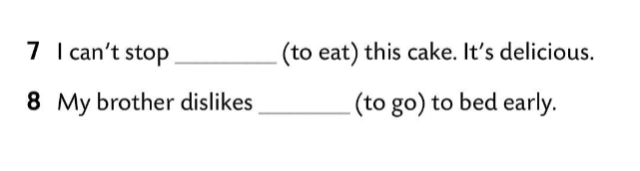
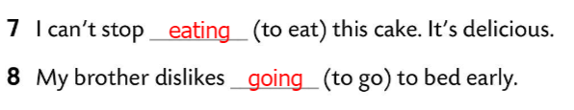
Workbook, page 13
Write questions about Ana, Lovro, Dino and Eva for these answers.
Check.
Write short answers for these questions.
Check.
Complete the sentences. Use the gerund form of these verbs.
Check.

Slide 9
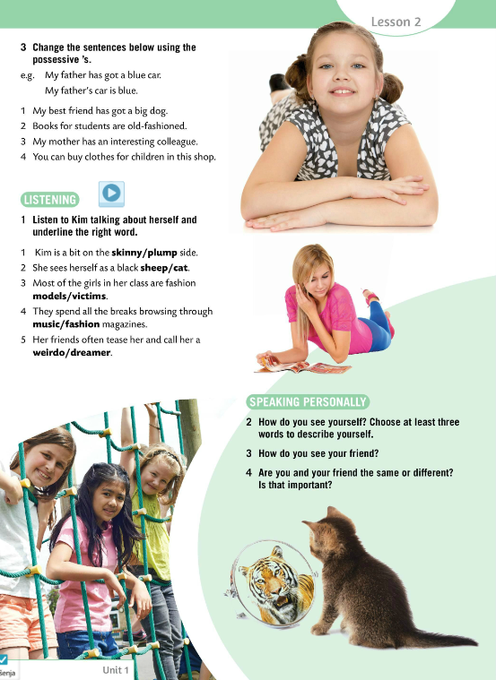
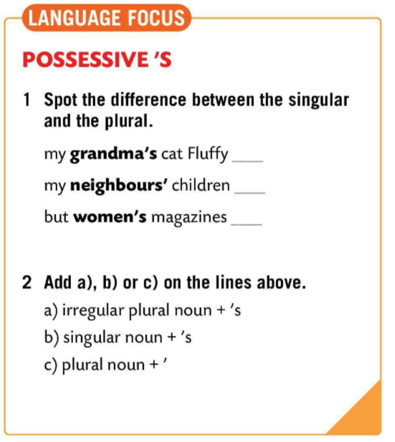
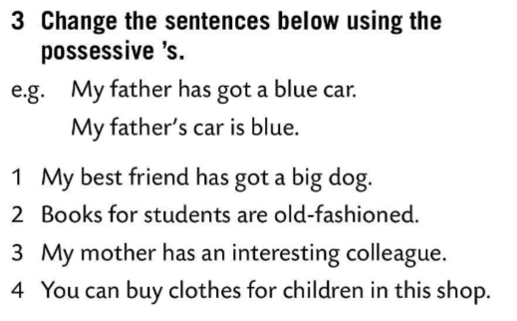
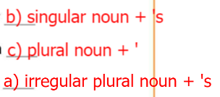
LANGUAGE FOCUS -POSSESSIVES
Spot the difference between the singular and the plural. Then add a), b), or c) on the lines above.
Check.
When the noun is in singular, we put an apostrophe before the –s ending.
Kod imenica u jednini najprije dolazi izostavnik pa nastavak -s.
My dog’s house.
When the noun is in plural we add an apostrophe at the end after the –s ending
Kod imenica u množini izostavnik dolazi nakon nastavka –s.
My dogs’ toys.
When we have irregular plural nouns (e.g. man→men, woman→women), we add an apostrophe before we add -s./
Kod imena s nepravilnom množinom dolazi najprije izostavnik, a zatim nastavak –s.
Women’s fitting rooms.
My best friend’s dog is big.
Students’ books are old-fashioned.
My mother’s colleague is interesting.
You can buy children’s clothes in this shop.
Change the sentences in Task 3 using the possessive ’s.

Slide 10
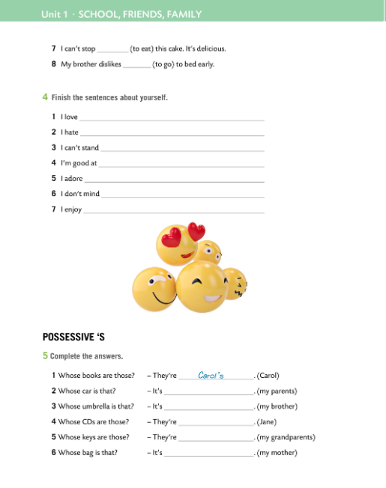
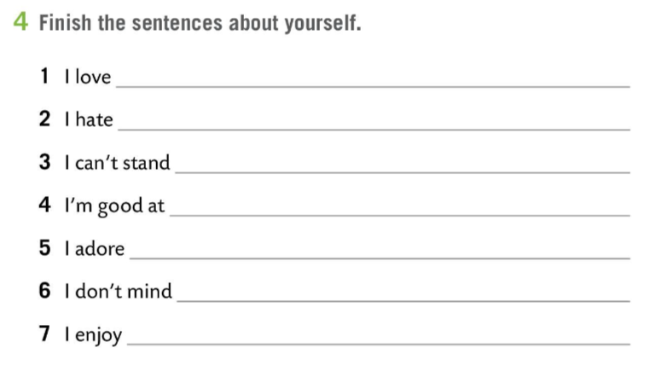
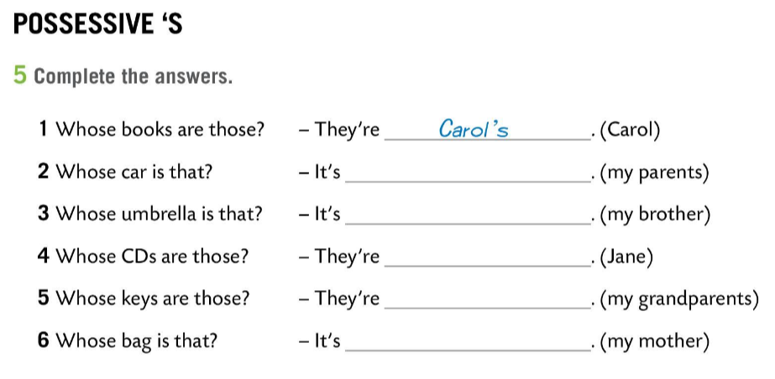
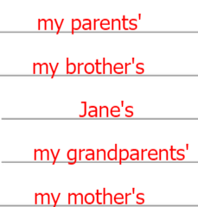
Workbook, page 14
Finish the sentences about yourself.
Complete the answers.
Check.

Slide 11
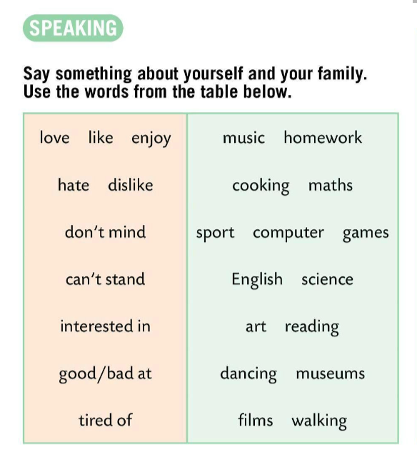

Say something about yourself and your family.
Use the words from the table.

Slide 12

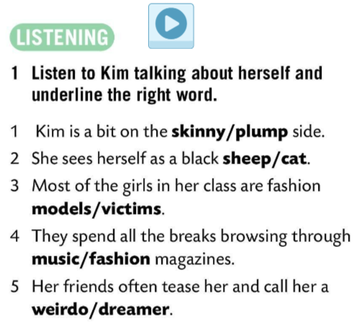
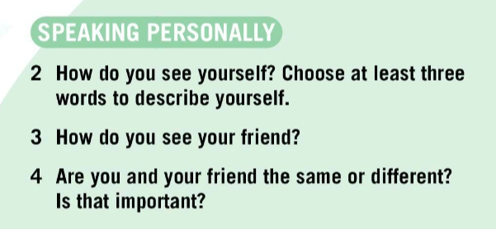
Listen to Kim talking about herself and underline the right word.
Check.
How do you see yourself? Choose at least three words to describe yourself.
How do you see your friend?
Are you and your friend the same or different? Is that important?
Play a game and revise vocabulary.
https://wordwall.net/play/843/306/588

Slide 13
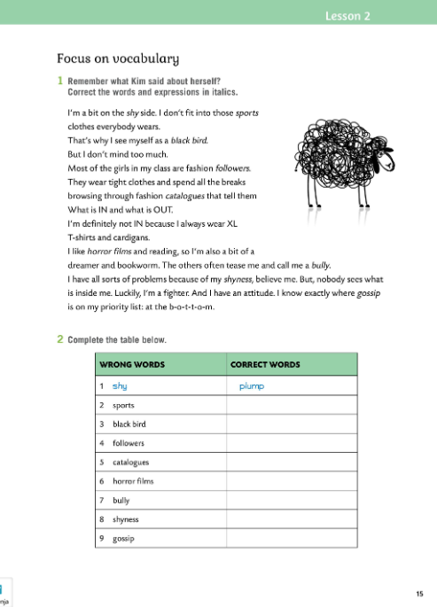
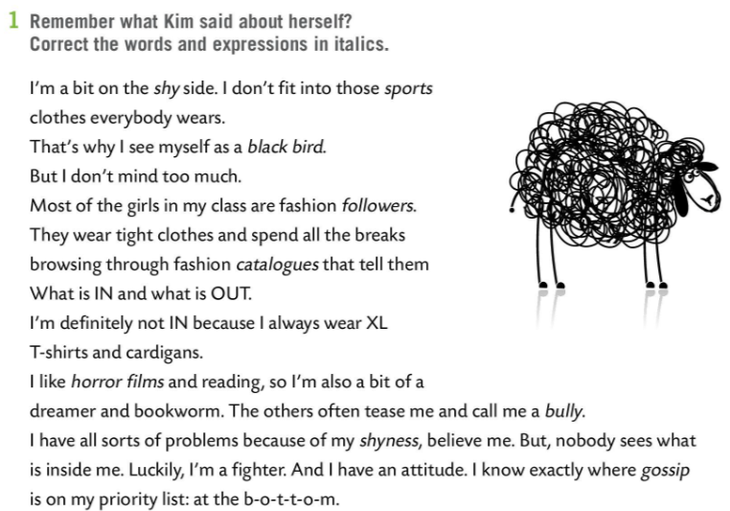
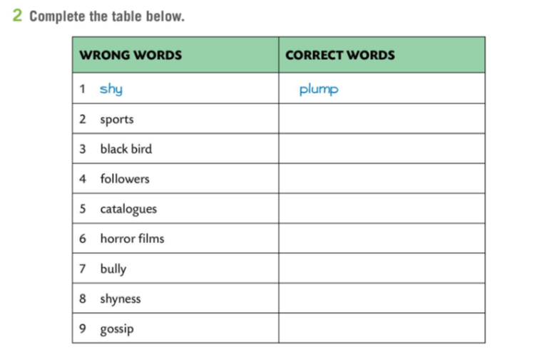
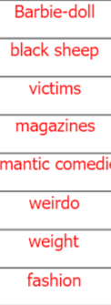
Workbook, page 15
Remember what Kim said about herself?
Correct the words and the expressions in italics.
Check.

